Slide 1
Destruction, Restoration, and Discourse
Exploring Wetland Restoration in the Iraq Marshes
Brooke Laird
Public Thesis Presentation
Notes:
30 min for presentation, 30 min for questions

Slide 2
01
Acknowledgements

Slide 3
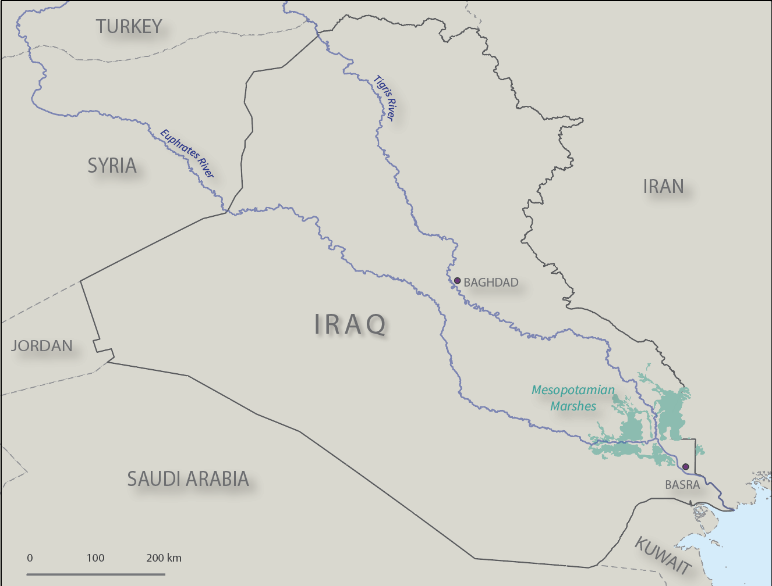
First, how did I get here?
Nature and Society in the Middle East
Geography of Climate Change Adaptation and Development
Remote Sensing and Land Use, and Remote Sensing RA work

Slide 4
Research Question
How do international organizations influence restoration priorities, narratives, and conceptions of wetlands in the marshes of Iraq through the creation of policy, boundaries, and maps?
Notes:
And with this background I have become really interested in questions that explore the human-environment relationship, specifically in regards to restoration and conservation.
This is a question that can be applied to many places that are experiencing environmental conflict, etc

Slide 5
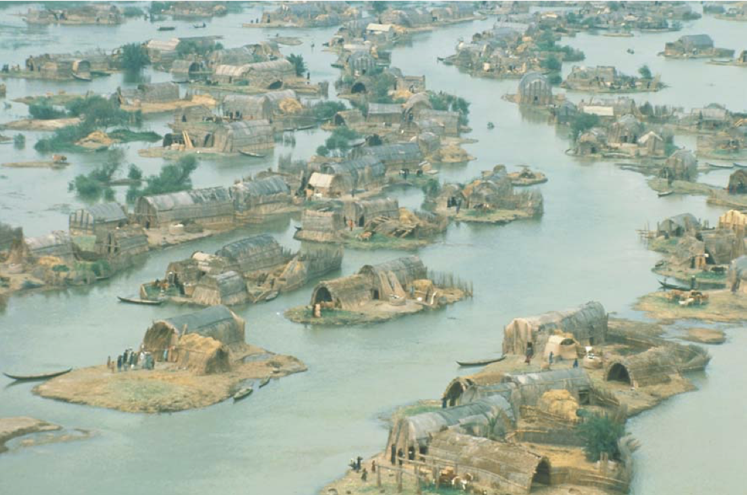
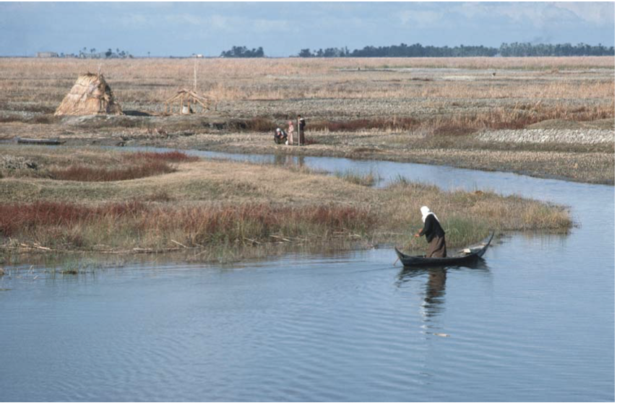
Geographic and Historical Context
Images from UNEP
Notes:
First I want to share the historical context of this project.
The marshes are a really culturally and historically significant place, known religiously as the the garden of eden
Historical significance as one of the first known human societies
Really unique example of human environment relationship
1950s–talk of draining for agricultural purposes
1990s– during and after the Gulf War, forced displacement, attack, and draining to about 20% of the original size

Slide 6
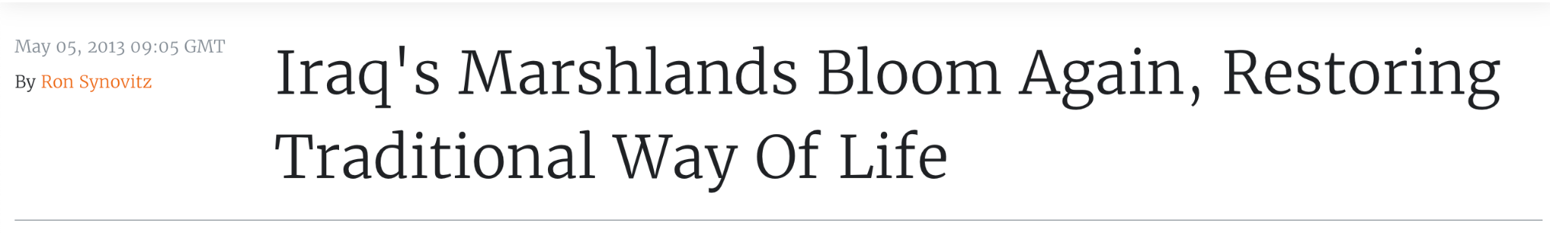
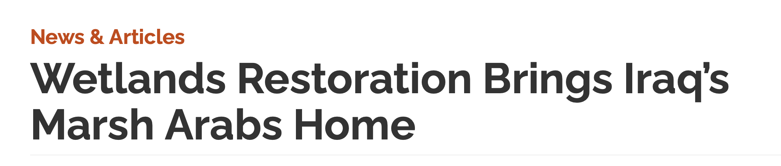
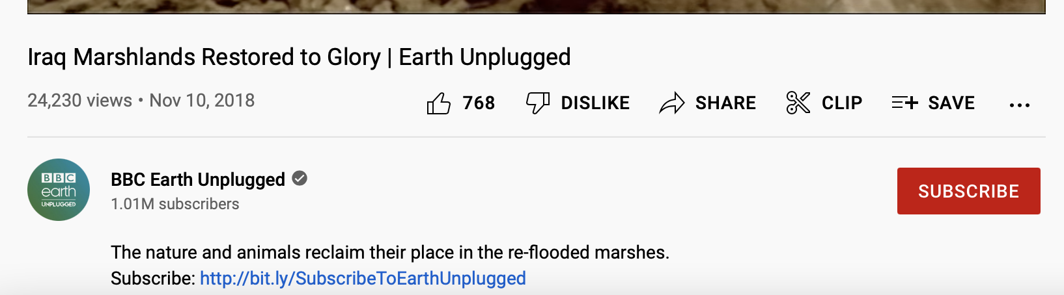

Slide 7
Study objectives
Policy Deconstruction
Map
Deconstruction
Map Creation
Who are the actors involved in wetland restoration and conservation, and what are they doing?
How are the wetlands represented cartographically, and what are the implications of the data and visuals?
How can cartography be used to expand existing narratives of wetland loss, and conceptions of wetlands?
Notes:
Important to note that in my original process i was only focused on the element of map creation, but I felt that step was missing important information that I found in the deconstruction sections of my thesis

Slide 8
Policy and Criteria Deconstruction
Notes:
What does it mean to deconstruct policy?

Slide 9

Literature & Deconstruction
Case Studies in Political Ecology
Neumann, Fairhead and Leach, Robbins
Existing Marshland Research on Expertise and Political Power
Bridget Guarasci (2011)
Notes:
A big question in this process is what does it mean to deconstruct policy? In my work i turn to inspiration from fundamental political ecology case studies
political ecology as a hatchet works to expose flaws in dominant approaches to the environment, often used by corporate, state, and international authorities.

Slide 10
Major Actors
RAMSAR
UNESCO
UNEP
Protection of wetland species, guiding nations in the wise use and management of wetlands
Identification and protection of sites with outstanding cultural value.
Support for issues involving environmental impact of conflict
Notes:
I focused on 3 major actors involved in wetland restoration
With ramsar and unesco this consisted of a review of wetland delineation criteria and reports that ramsar produced for outlining the destruction of the wetlands
For UNEP this more focused on the produced policy, and how the organization was acting at the local, fed, and international level

Slide 11
Results
Local Groups
Scale
Influence
Services
Ramsar
UNESCO
UNEP
Notes:
To keep things more simple i consolidated my results into a table
What is the scale that these organizations are operating at
How are the local groups and their needs acknowledged
What influences do these actors have for local restoration
As an extension of part 3–what services are being provided

Slide 12
Deconstructing the Map (and other Data Sources)
Notes:
This continues to build on my foundation of policy deconstruction, but begins to incorperate more of a focus on wetland boundaries and map visuals

Slide 13
Literature & Map Deconstruction
Case Studies in Political Ecology
Fairhead and Leach, Robbins
Deconstruction Theory
Harley (map focus), Harvey (data), Schurmann (data)
Map making (data, methodology, producer)
Reading through the lines of this visual
Maps as a form of power and knowledge
Notes:
Again, in this section we are continuing with the theme of deconstruction (with our hatchet)
I return to two case studies that were used above

Slide 14
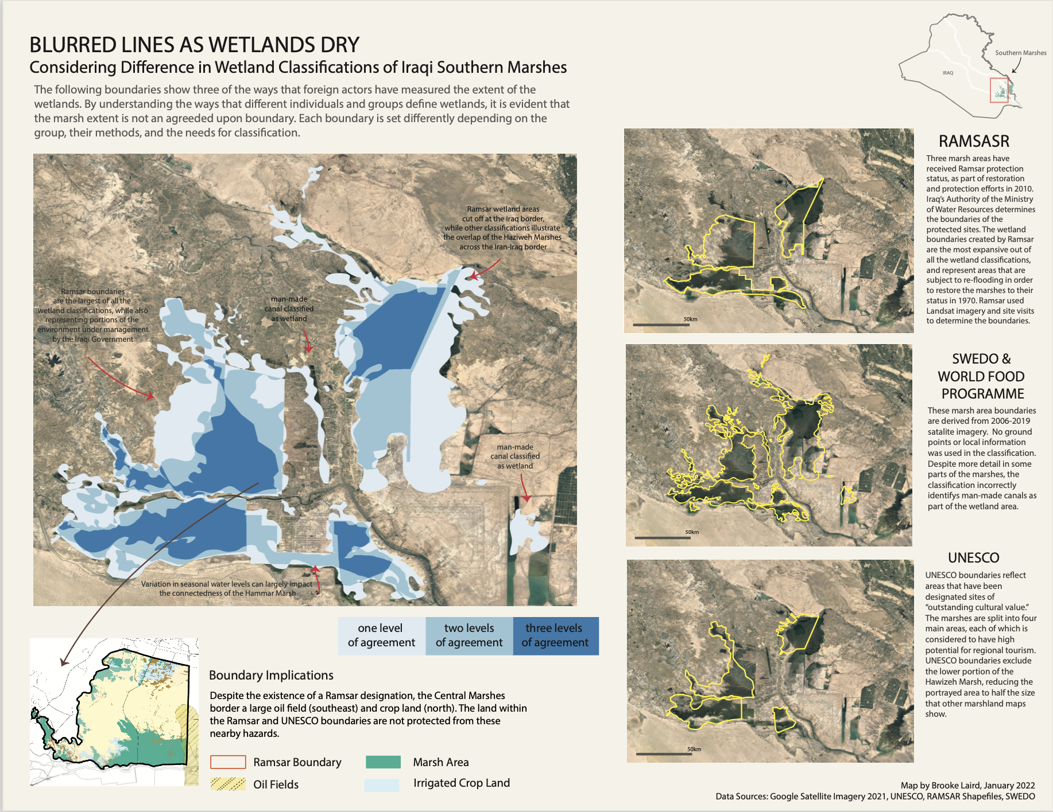
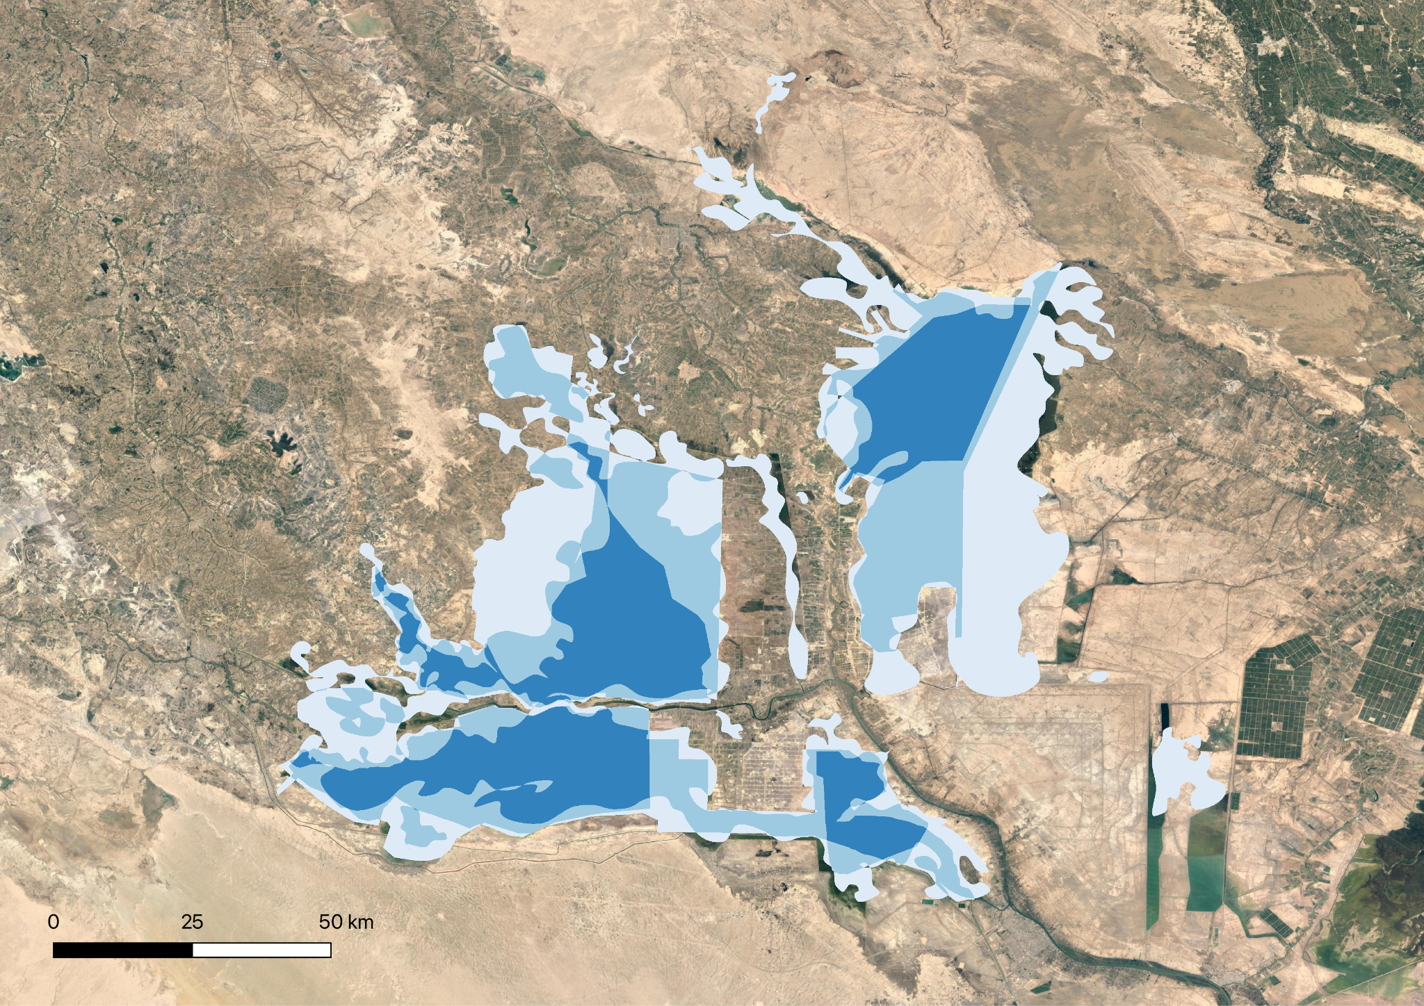
A Critique of Remote Sensing
Notes:
So to compare the boundaries, that are based off of the criteria for delineating wetlands used above, i used remote sensing methods to

Slide 15
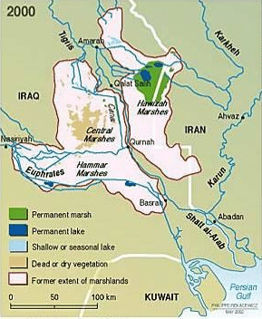
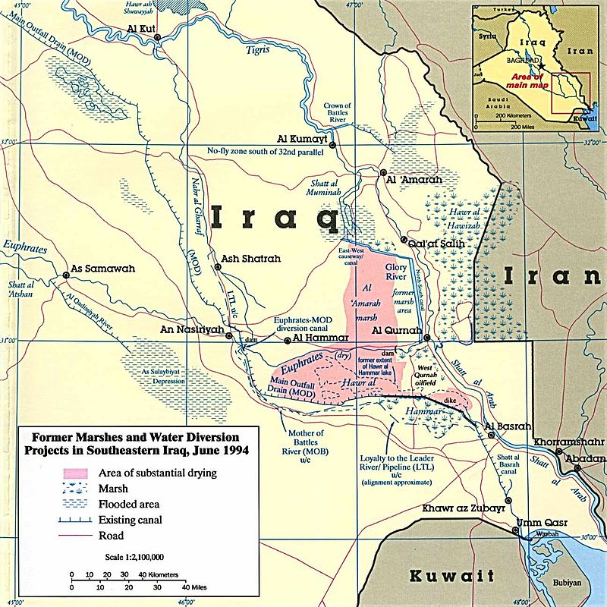
(put two maps)
Data and Tools
Visual
Maps as power and knowledge
UNEP 2001
CIA, 1990
Notes:
Map making as a discipline
Reading through the lines of this visual
Maps as a form of power and knowledge
UNEP:
Huge international presence
Land cover classification is mostly based on the ecological components of a wetland
Very little information about methodology, but UNEP did state that it was used to get an understanding of the extent, no ground truthing
Visually, focus on former extent. But in this creation we dont know what is there now as landcover
CIA: - part of a larger report about the politics of the destruction
- derived from landsat, but no specifications about image used or the methodology
Big takeaways:
Powerful maps that come from well known producers, that have been heavily circulated because of their reliability
Upon first glance they appear to tell the same story, but really they convey that maps can have a different narrative once deconstructed
Circulated out of initial context, still being circulated today! These maps were created over 20 years ago, and they cannot still serve as references for the wetlands of Iraq

Slide 16
Narrative Cartography

Slide 17

Literature and Cartographic Sources
Narrative Cartography
“Mapping focused on capturing neglected knowledge about the past, while also exploring new visions for the future of the landscape” (Couling 2010).
Regional Ethnography
Salim, Guarasci and Damluji

Slide 18
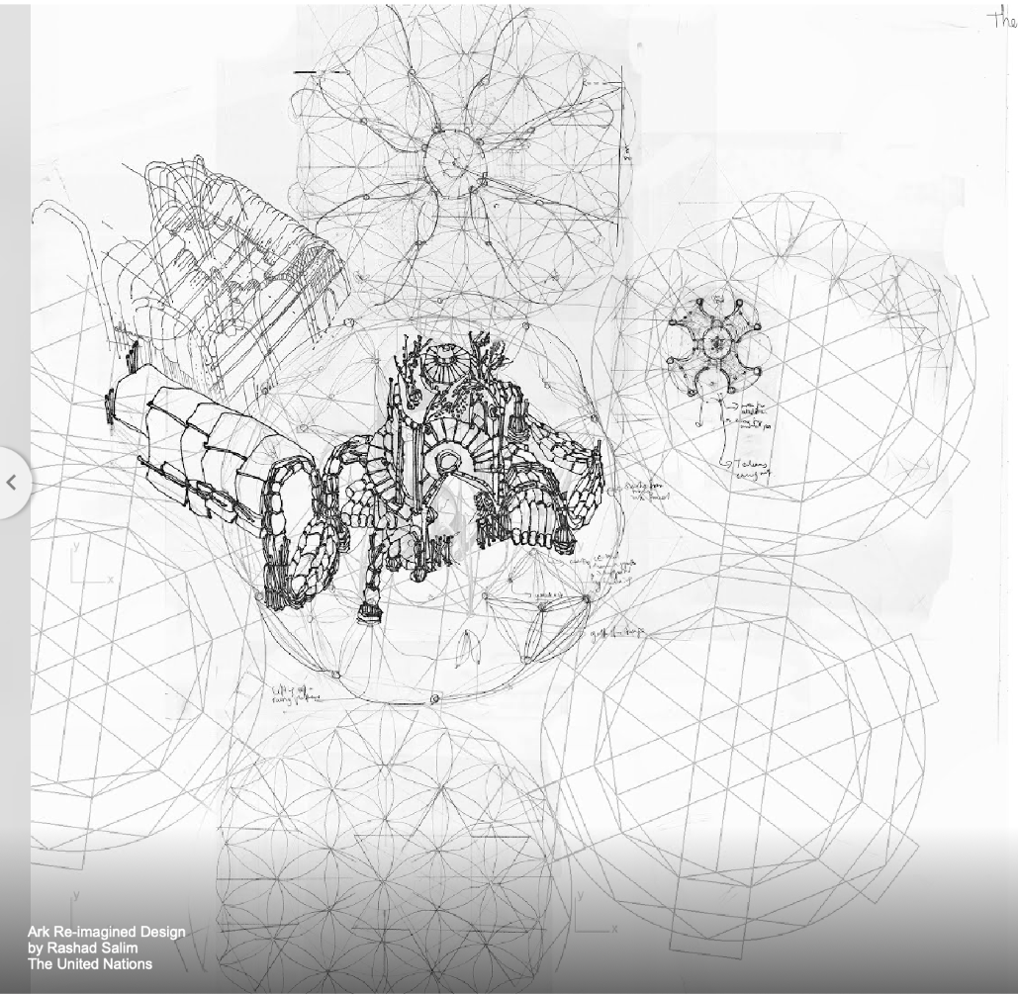
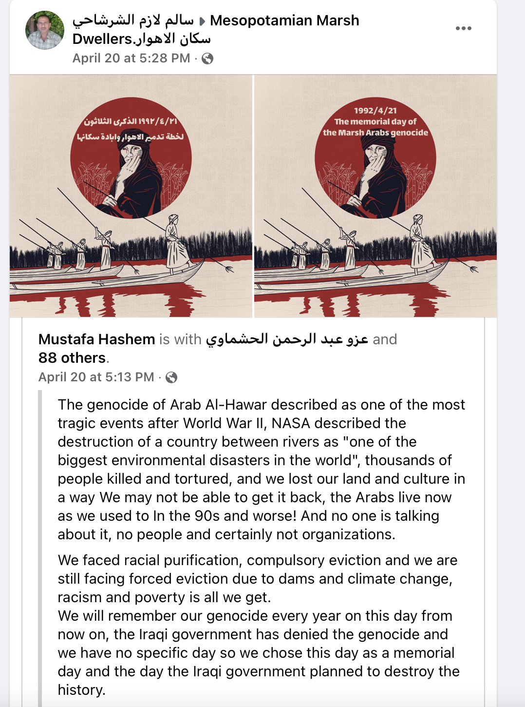
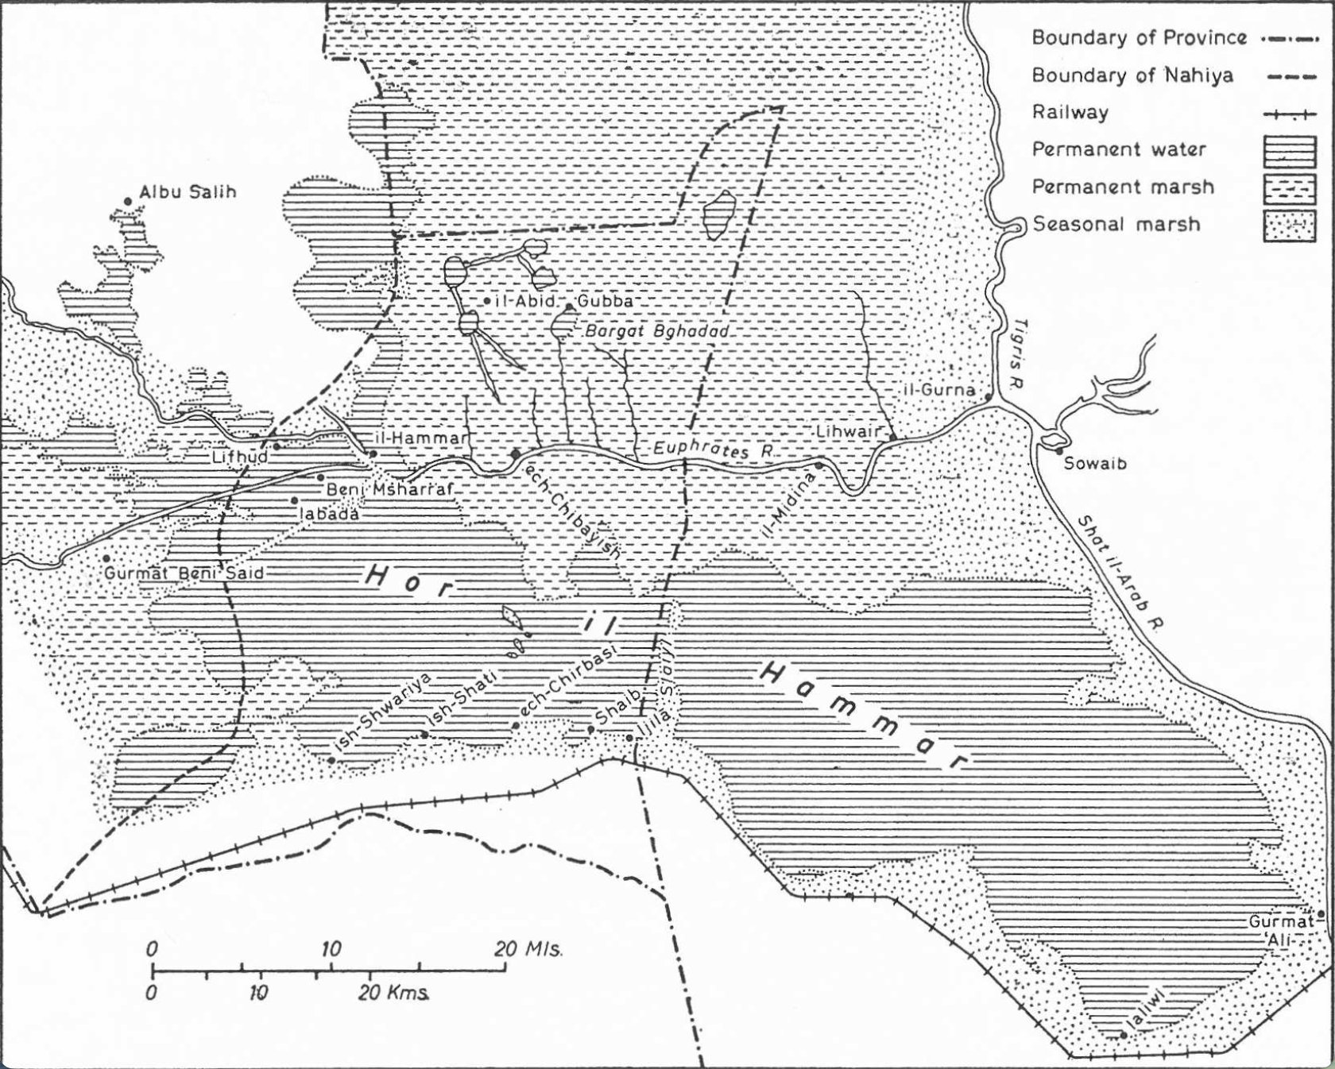
Data Beyond the Satellite
Notes:
Without access to participatory mapping or interviews

Slide 19
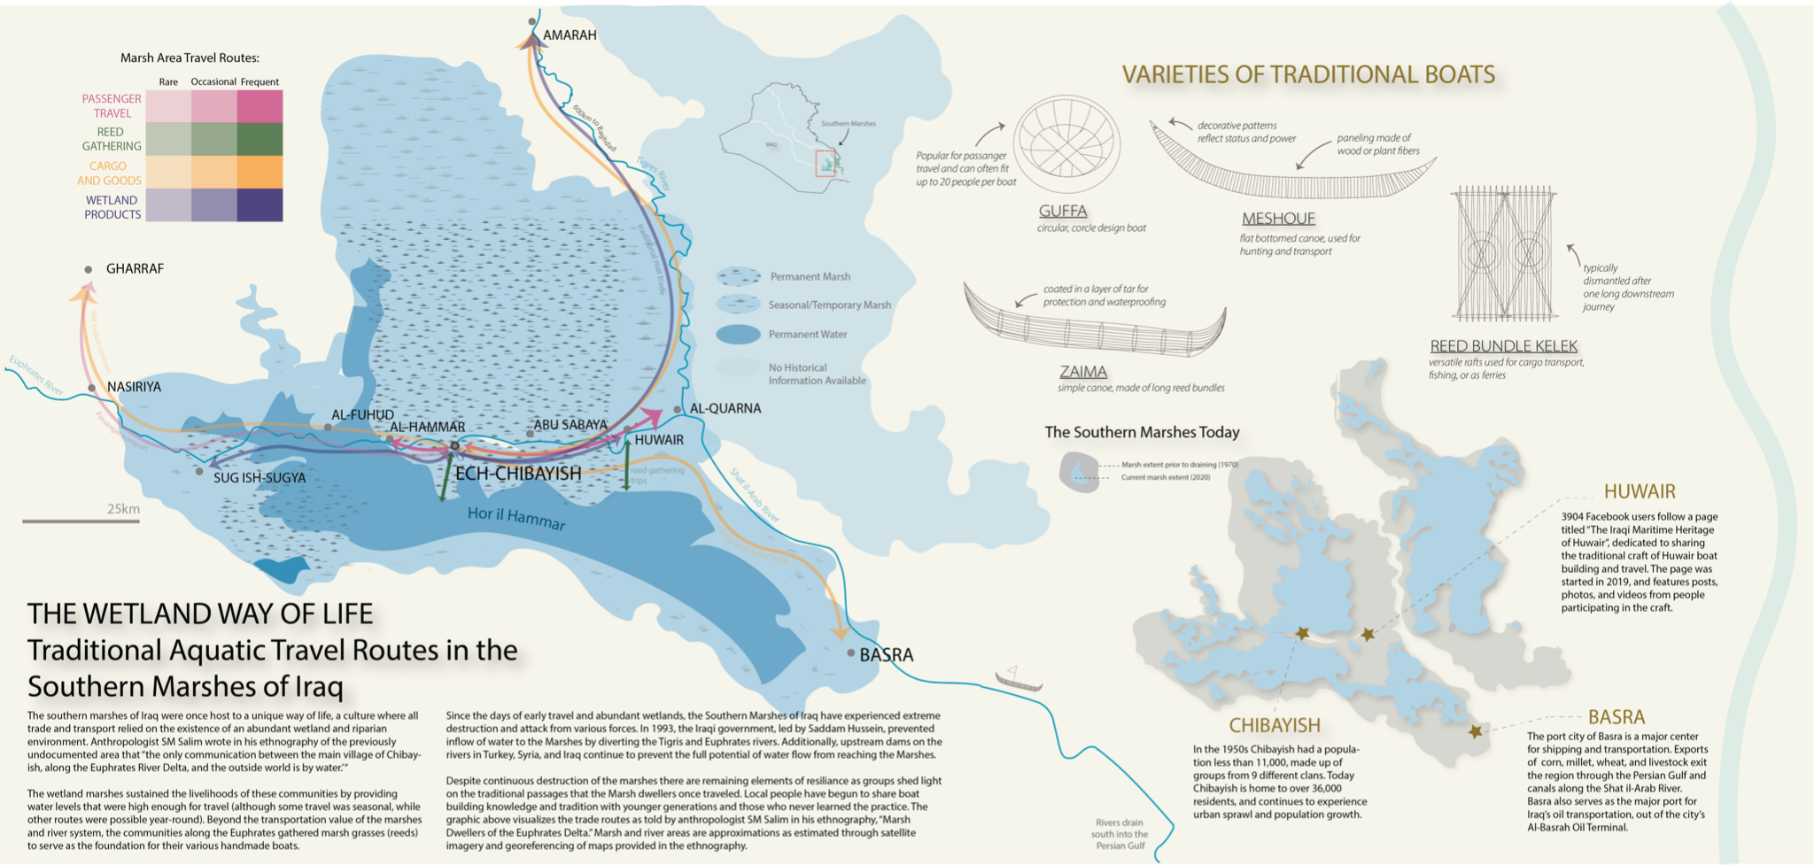

Slide 20
Study objectives
Policy Deconstruction
Map
Deconstruction
Map Creation
Who are the actors involved in wetland restoration and conservation, and what are they doing?
How are the wetlands represented cartographically, and what are the implications of the data and visuals?
How can cartography be used to expand existing narratives of wetland loss, and conceptions of wetlands?
Notes:
As i begin to wrap it up, i want to Return one last time to my study objectives

Slide 21
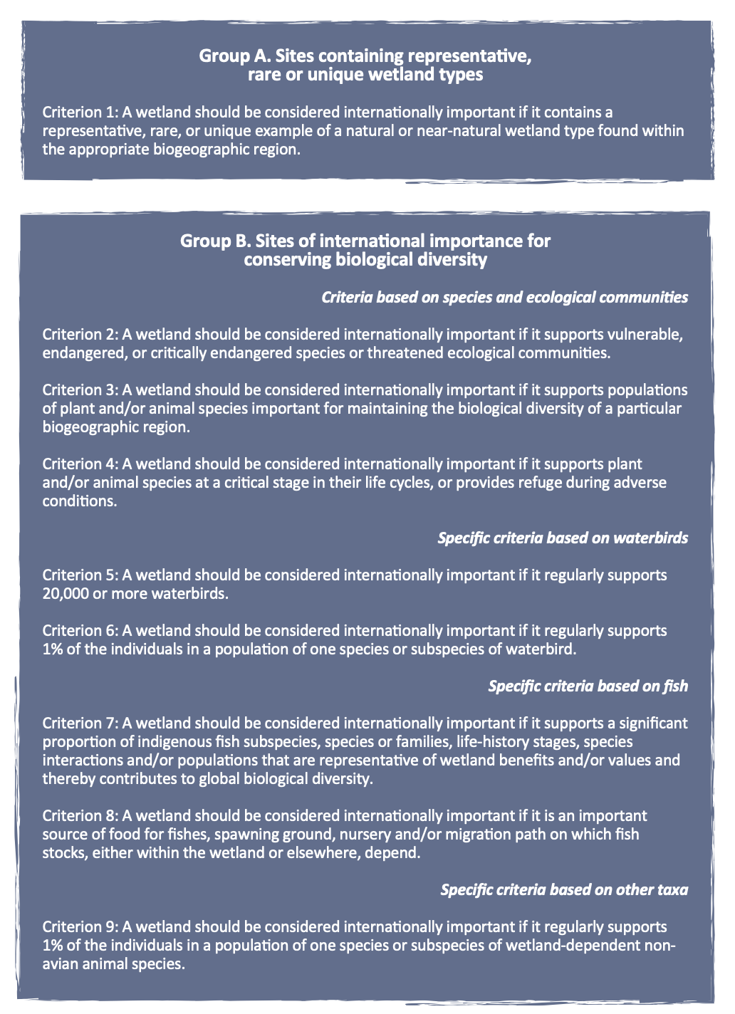
Restoration and conservation efforts in the Iraqi Marshes are insufficient in addressing the needs of local communities
we see this in through…
Notes:
We see this through:
International actors performing distanced restoration, that not only occurs on an international scale and from a distance, but using technology that allows for a removal from the region of focus
Outdated and overcirculed maps with unclear methodology that tell a narrow story of loss
A lack of consideration of a local perspective

Slide 22
Broader Implications
01
02
03
04
More to a landscape than the satellite image
Wetlands hold significance beyond the ecological meaning
Need for expansion of narrative cartography and mixed sources
Need for ongoing environmental research in the Middle East
Notes:
More broadly, there are takeaways that can be applied to future studies in political ecology, restoration and development studies
I hope you all leave here with new information about a significant environmental catastrophe that goes unacknowledged, and a new desire to think critically about the maps in front of you

Slide 23
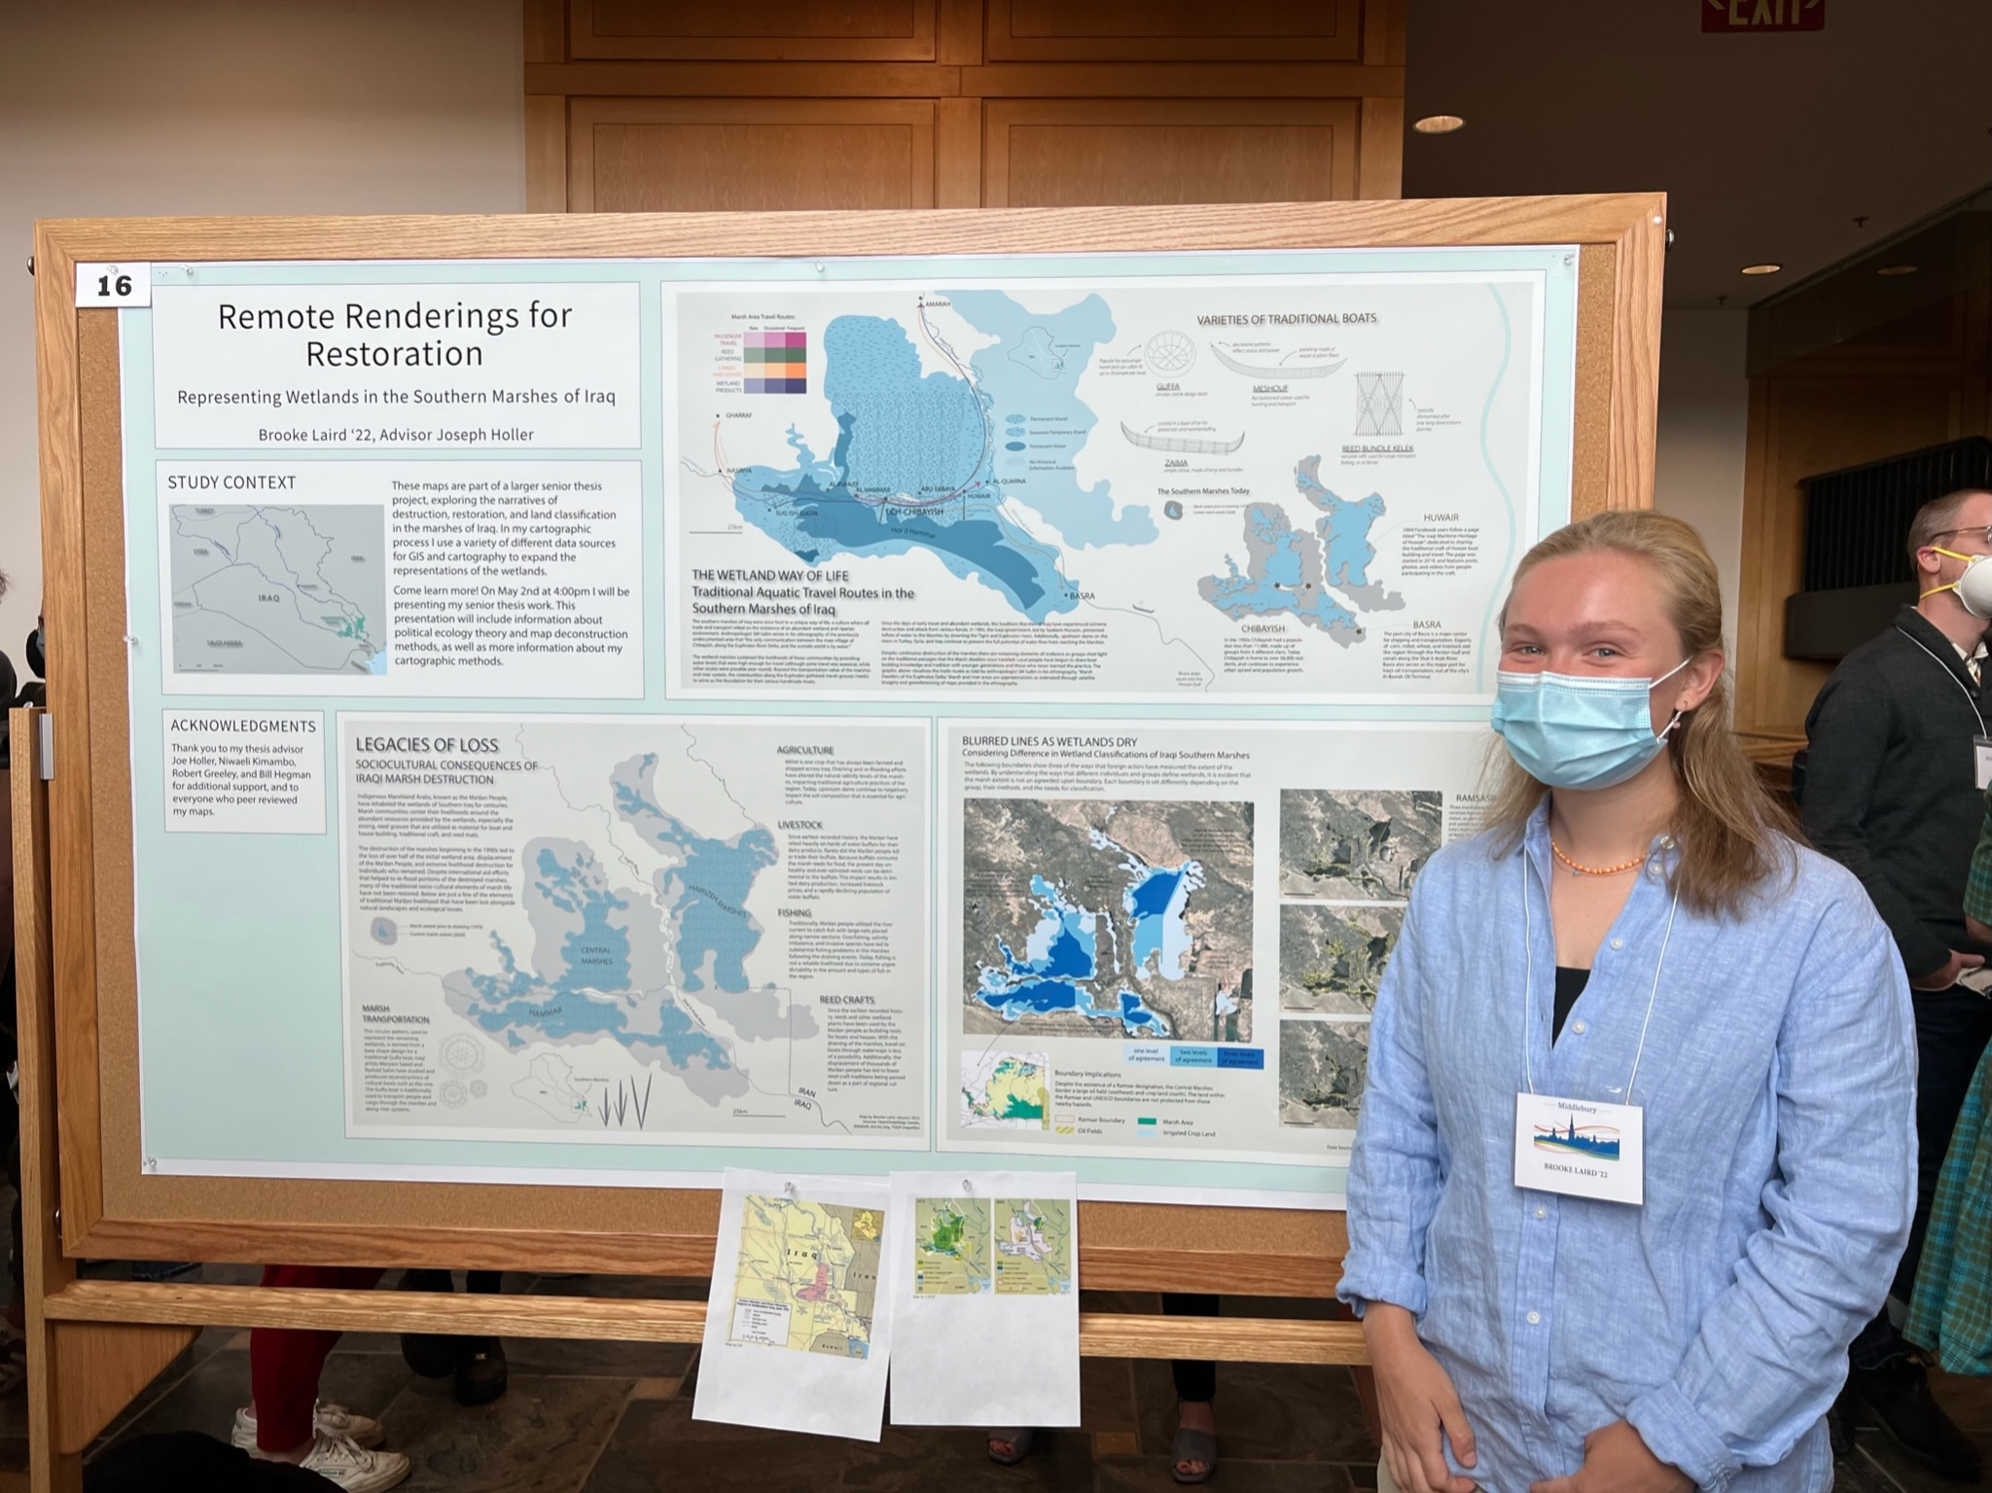
Thank You!
Contact information:
bclaird@middlebury.edu
brookelaird.github.io
Brooke Laird on LinkedIn
Notes:
Git hub has my sources and google earth engine scripting

Slide 24
Bibliographical references
Almahmood, H. (2010). Study of Some Physical and Chemical Characterizations of water from Southern Iraqi Marshlands after Rehabiliation/2003. Uruk Refereed Scientific Journal.
Al-Mudaffar Fawzi, N., & Mahdi, B. (2014). Iraq’s inland Water quality and their impact on the North-Western Arabian Gulf Introduction. Marsh Bulletin.
Chrisman, N. R. (1999). What Does ‘GIS’ Mean? Transactions in GIS, 3(2), 175–186. https://doi.org/10.1111/1467-9671.00014
CIA. (2001). The Destruction of Iraq’s Southern Marshes.
https://www.cia.gov/readingroom/docs/DOC_0000541147.pdf
CNN.com—Iraq marshes. (n.d.). Retrieved January 9, 2022, from https://www.cnn.com/interactive/maps/world/fullpage.iraq.marshes/index.html
Cortines, A. C., Possidônio, R. D., Bahia, N. C. F., Oswaldo Cruz, J. C. H., Esteves de Freitas, L., & Gallo, E. (2018). Social Cartography and the Defense of the Traditional Caiçara Territory of Trindade (Paraty, RJ, Brazil). In W. Leal Filho & L. Esteves de Freitas (Eds.), Climate Change Adaptation in Latin America: Managing Vulnerability, Fostering Resilience (pp. 445–456). Springer International Publishing. https://doi.org/10.1007/978-3-319-56946-8_27
Couling, N., Alfaro D’Alençon, P., & Altiok, M. (2019). Narrative Cartography: Capturing a Holistic Perspective on Waterscapes. European Journal of Creative Practices in Cities and Landscapes, Vol 2, 11-36 Pages. https://doi.org/10.6092/ISSN.2612-0496/8808

Slide 25
Bibliographical references
Harley, J. B. (1989). Deconstructing the map. Cartographica: The International Journal for Geographic Information and Geovisualization, 26(2), 1–20. https://doi.org/10.3138/E635-7827-1757-9T53
Harvey, F., & Chrisman, N. (1998). Boundary Objects and the Social Construction of GIS Technology. Environment and Planning A: Economy and Space, 30(9), 1683–1694. https://doi.org/10.1068/a301683
Hasheem, M. (2022, April 21). Mesopotamian Marsh Dwellers [Group Post].
Kelly, M. (2019). Mapping Syrian Refugee Border Crossings: A Feminist Approach. Cartographic Perspectives, 93, 34-64-34–64. https://doi.org/10.14714/CP93.1406
McCusker, B., & Weiner, D. (2003). GIS Representations of Nature, Political Ecology, and the Study of Land Use and Land Cover Change in South Africa. Political Ecology: An Integrative Approach to Geography and Environment-Development Studies.
Neumann, R. P. (2002). Imposing Wilderness: Struggles over Livelihood and Nature Preservation in Africa.
de Almeida, R. A. (2014). Chapter 8 - Inclusive Cartography: Theoretical and Applied Issues in Brazil. In D. R. F. Taylor (Ed.), Modern Cartography Series (Vol. 5, pp. 107–127). Academic Press. https://doi.org/10.1016/B978-0-444-62713-1.00008-8
Desk study on the environment in Iraq. (2003). United Nations Environment Programme.
Environment, U. N. (2017, August 4). Iraq. UNEP - UN Environment Programme. http://www.unep.org/explore-topics/disasters-conflicts/where-we-work/iraq
Fairhead, J., & Leach, M. (1996). Misreading the African Landscape: Society and Ecology in a Forest-Savanna Mosaic. Cambridge University Press. https://doi.org/10.1017/CBO9781139164023

Slide 26
Bibliographical references
Schuurman, N. (2008). Database Ethnographies Using Social Science Methodologies to Enhance Data Analysis and Interpretation. Geography Compass, 2(5), 1529–1548. https://doi.org/10.1111/j.1749-8198.2008.00150.x
Soave, A., Obaid, H., Rohmer, N., & Mahmood, S. (2018). Addressing Expansion Needs in the Town of Qalat Saleh, Maysan Governorate. https://doi.org/10.13140/RG.2.2.12131.30249
Swedo – The Swedish Development Aid organization. (n.d.). Retrieved April 29, 2022, from https://swedoaid.org/
The Iraqi Maritime Heritage of Huwair Facebook Group. (2019). https://www.facebook.com/%D8%A7%D9%84%D8%AA%D8%B1%D8%A7%D8%AB-%D8%A7%D9%84%D9%85%D9%84%D8%A7%D8%AD%D9%8A-%D8%A7%D9%84%D8%B9%D8%B1%D8%A7%D9%82%D9%8A-%D9%81%D9%8A-%D8%A7%D9%84%D9%87%D9%88%D9%8A%D8%B1The-Iraqi-Maritime-Heritage-of-Huwair-817172805291933/?ref=page_internal
Pelham, N. (n.d.). A New Ark. Lapham’s Quarterly. Retrieved January 9, 2022, from https://www.laphamsquarterly.org/water/new-ark
Robbins, P. (2001). Fixed Categories in a Portable Landscape: The Causes and Consequences of Land-Cover Categorization. https://journals.sagepub.com/doi/abs/10.1068/a3379
Saeed, M. (2017). Computation and Craft.
Safina Projets. (2017). Safinaprojects. https://www.safinaprojects.org/atlas-ark
Salim, S. M. (2021). Marsh Dwellers of the Euphrates Delta. Routledge.
Scaramelli, C. (2018). “THE WETLAND IS DISAPPEARING”: CONSERVATION AND CARE ON TURKEY’S KIZILIRMAK DELTA. International Journal of Middle East Studies, 50(3), 405–425. https://doi.org/10.1017/S0020743818000788

Slide 27
Bibliographical references
This is not an atlas. (n.d.). This is not an atlas. Retrieved January 7, 2022, from https://notanatlas.org/es/
UNEP. (2001). Demise of Mesopotamian Marshes.
UNEP. (2005). Iraqi Marshlands Observation System UNEP Technical Report.
UNEP. (2007). UNEP in Iraq: Post Conflict Assessment, Clean-Up and Reconstruction.
UNEP. (2017, September 16). Vital Water Graphics: An Overview of the State of the World’s Fresh and Marine Waters. UNEP - UN Environment Programme. http://www.unep.org/resources/report/vital-water-graphics-overview-state-worlds-fresh-and-marine-waters
UNESCO. (n.d.-a). The Ahwar of Southern Iraq; Refuge of Biodiversity and the Relict Landscape of the Mesopotamian Cities. UNESCO World Heritage Centre. Retrieved April 29, 2022, from http://whc.unesco.org/en/list/1481/
UNESCO. (n.d.-b). The Criteria for Selection. UNESCO World Heritage Centre. Retrieved April 29, 2022, from https://whc.unesco.org/en/criteria/
United Nations Environment Programme—2003—Desk study on the environment in Iraq.pdf. (n.d.). Retrieved April 29, 2022, from https://postconflict.unep.ch/publications/Iraq_DS.pdf
Wetlands International welcomes new Iraq-Iran cooperation on Mesopotamian marshes | Dutch Water Sector. (2018). https://www.dutchwatersector.com/news/wetlands-international-welcomes-new-iraq-iran-cooperation-on-mesopotamian-marshes

Slide 28
Questions?

Slide 29
